Slide 1
TANK
WARS
Mini project Phase II CS210

Slide 2
Overview
Get ready for explosive battles and strategic tank warfare in Tank Wars! This classic 2D artillery game pits you against your friends in a battle to the glory, where the only way to survive is to land the perfect shot. So grab your friends, hop in your tank, and get ready to blast your way to victory!
C based
Multiplayer game
FPGA NIOS II

Slide 3
Mechanics of the game
The game physics simulate realistic projectile motion, adding an extra layer of complexity to the gameplay.
Players can adjust the angle and power of their shots, making it challenging and strategic.
Players need to carefully calculate the trajectory of the projectile to ensure it hits the target.
To make the bouncing of bombs more realistic, the game incorporates the coefficient of restitution, which determines how much energy is lost during a collision.
Players can also adjust their horizontal position to blast the perfect shot.

Slide 4
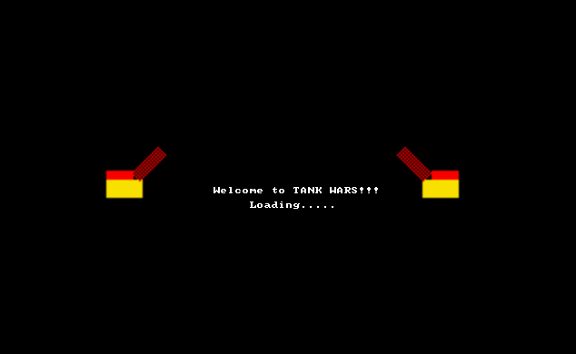
Lets dive in…

Slide 5
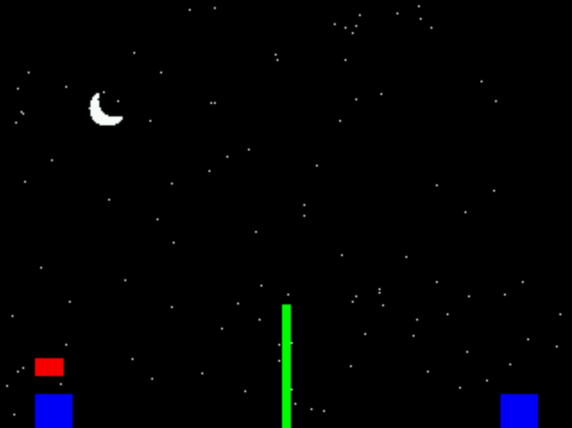
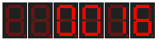

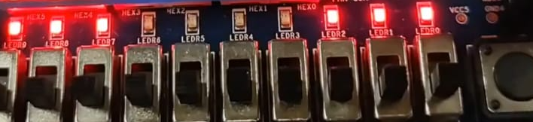
Power
Health Indicators

Slide 6
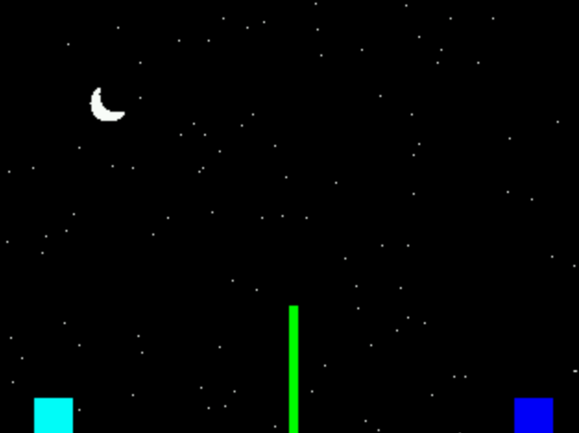
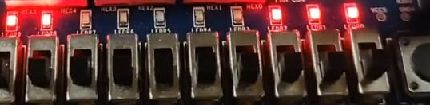
Blue -> Cyan -> Red -> Dead
Health Indicators
Health of player A was decreased by 1
And its color is changed.

Slide 7
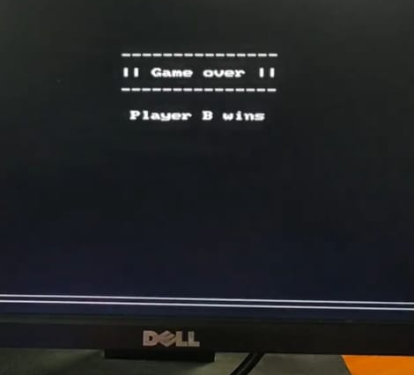
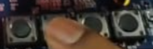
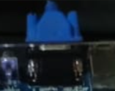
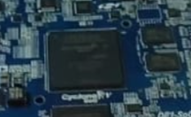

Slide 8
Thank you
CS 210
Mini Project Phase 2
Under the guidance of :
Prof. Jimson Mathew
IIT Patna

